Slide 1

Los Angeles Crimes Report (2020-2023)
By : Ahmed Bedair

Slide 2

Table of contents
01
02
03
2022
Introduction
Dashboard Explanation
Final Thoughts

Slide 3

01
Introduction
Academy

Slide 4

Introduction
This Dataset contains all of the recorded crime data in the city of Los Angeles between the years of 2020 to 2023 that contains everything from the time the crime was reported, the type of crime committed, as well as the longitude and latitude which the crime was committed.

Slide 5

Project KPIS
- Most Popular Details about Crimes
- Crime Rates Over Years

Slide 6
Steps Before Dashboarding
Before We made our Dashboard to visualize our data we’ve made some steps to make our data ready for dashboarding stage :
- Importing and Exploration
- Dropping unnecessary columns
- Imputing and removing nulls
- Making Basic visualizations before dashboarding

Slide 7
02
Dashboard
Academy

Slide 8
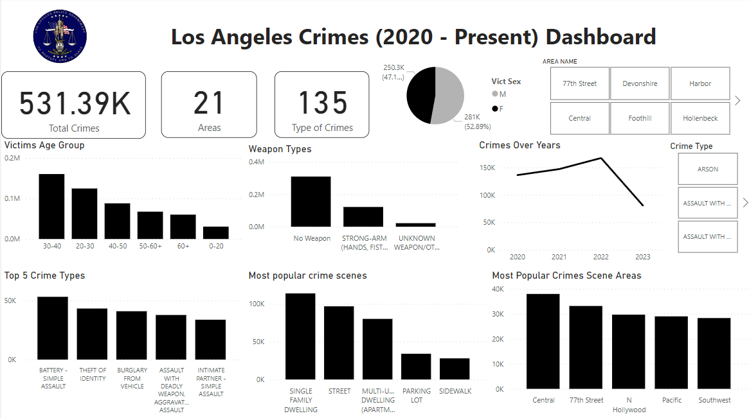
Dashboard

Slide 9
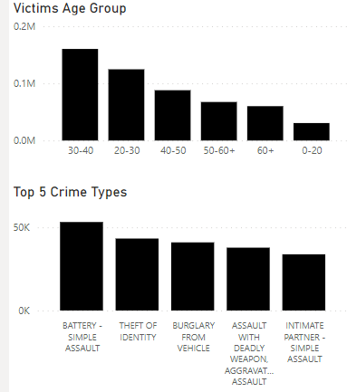
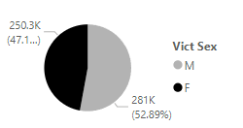
Most Popular Crimes Type
We Can See here that the Most Popular Crimes Happens for Adult Males between 30 and 40 year’s Old By Getting Assaulted

Slide 10
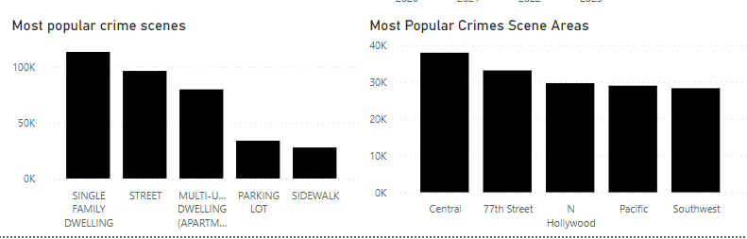
Most Popular Crimes Areas and Places
We Can See here that the Most Popular Crimes and Assualts happens for Family Dwellings In Central

Slide 11
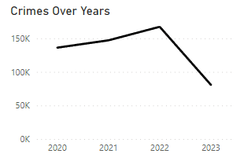
Crimes Rate
We Can See here that the Crimes rate increased Between 2020 and 2022 But Decreased in 2023

Slide 12
03
Final thoughts
Academy

Slide 13
Final Thoughts
- the Most Popular Crimes Happens for Adult Males between 30 and 40 year’s Old By Getting Assaulted
- the Most Popular Crimes and Assaults happens for Family Dwellings In Central that this Area Must be More Secured by increasing Police individuals there
- Finally, the Most Popular Crimes and Assaults happens for Family Dwellings In Central thanks For LAPD Efforts 😊❤

Slide 14
Resources
Dataset link : https://www.kaggle.com/datasets/nathaniellybrand/los-angeles-crime-dataset-2020-present

Slide 15
Thank You
Academy

